Slide 1
Going Live

Slide 2
Check-Up Session
How’s it going?
After 1 week of Bootcamp, how are you holding up?
(are you in the fire or is the fire in you?)

Slide 3

Instructor Feedback
Seriously, mind-blown.

Slide 4
Instructor Feedback
Things I’ve noticed people doing incredibly well:
All of you are handling an enormous volume of information.
All of you are asking the right questions.
You notice the right details.
You all help each other out.
And, most importantly, you are figuring out things on your own.

Slide 5
A Few Admin Things…

Slide 6
Instructor Feedback
Remember, Homework #1 is due on Saturday.
Homework Link:
http://smu.bootcampcontent.com/SMU-Coding-Bootcamp/SMDA201801FSF4-Class-Repository-FSF/tree/master/01-Class-Content/01-html-git-css/02-Homework/Instructions
Remember to submit Homework via Boot Camp Spot
And seriously!
Submit whatever you have! Don’t get a 0.
(Even if you don’t like what you’ve made.)

Slide 7
Office Hours + Additional Help
Also, remember….
In Class Office Hours: 45 minutes before class, 30 minutes after.
Review In Class Material (Exercises and Slides) - It’s all in your class repo – just do a git pull every few days to get the latest
Watch the pre-recorded videos in the video guide
Re-Watch Class Videos:
https://codingbootcamp.hosted.panopto.com/Panopto/Pages/Sessions/List.aspx?folderID=d623fb7f-c667-4636-b61d-a86b0027c690
Pro tip: You can watch at 2X speed and make everyone sound like chipmunks.

Slide 8
Recapping

Slide 9

Recap
In just one whirlwind week we’ve covered:
Full-Stack Development Conceptually
Terminal / Git Bash
HTML Syntax
Git Concepts and Commands
CSS Purpose, Syntax, and Styles
Floating
Positioning
Box Model
Chrome Dev Tools
How to Learn on Your Own!!

Slide 10

Full-Stack Development?

Slide 11

> Intro to Console

Slide 12


<title> Intro to HTML </title>
HTML is one of the three base languages behind every single website.
It defines all of the basic content and a bit of formatting.

Slide 13



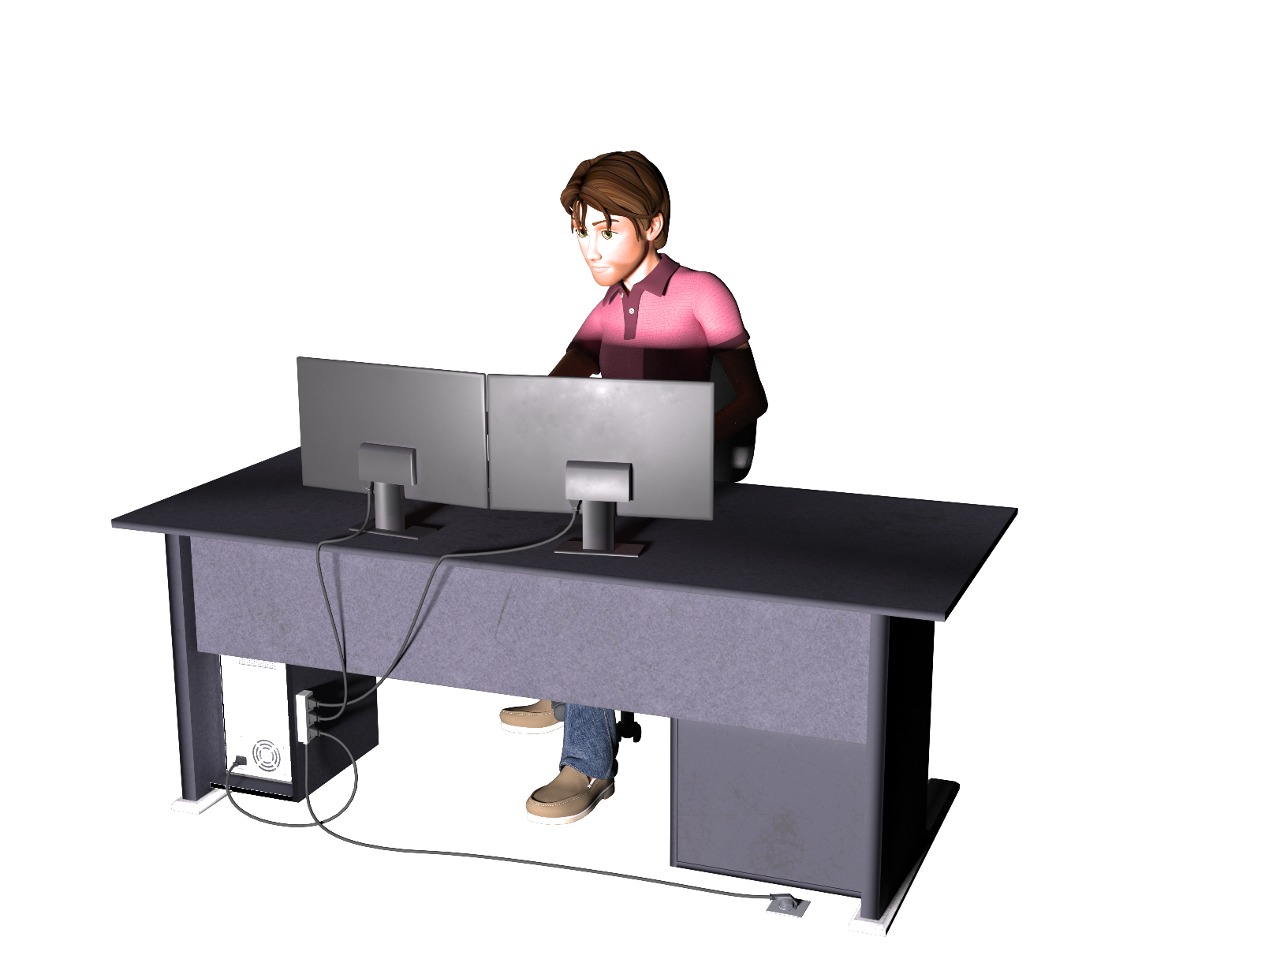

Pushing and Pulling to GitHub
1
2
3
4
GitHub Branch
Pull Code
Push Code
Pull Code
Pull Code
Push Code
Pull Code
Push Code

Slide 14

CSS Syntax
CSS works by hooking onto selectors added into HTML using “classes and identifiers”.
Once hooked, we apply styles to those HTML elements using CSS.

Slide 15

The Concept of “Flow”
In HTML/CSS, (by default) every element displayed is governed by a concept called “flow.”
This means that HTML elements force their adjacent elements to flow around them.

Slide 16
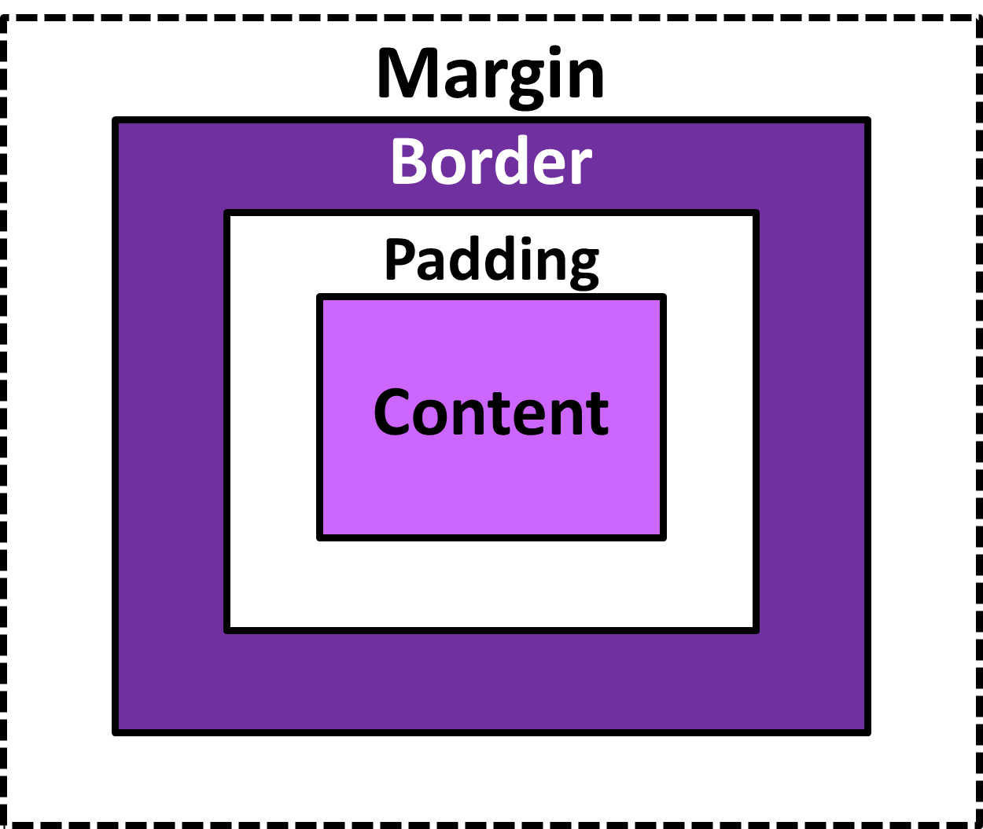
The Box Model
The Box Model wraps every CSS element in padding, border and margin – allowing developers to modify spacing styles.

Slide 17

CSS Positioning
We can orient our HTML elements in relation to space with CSS positioning (static, relative, fixed, absolute).

Slide 18









How to Learn…

Slide 19

General Questions / Issues?

Slide 20
Double Take

Slide 21
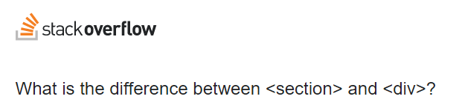
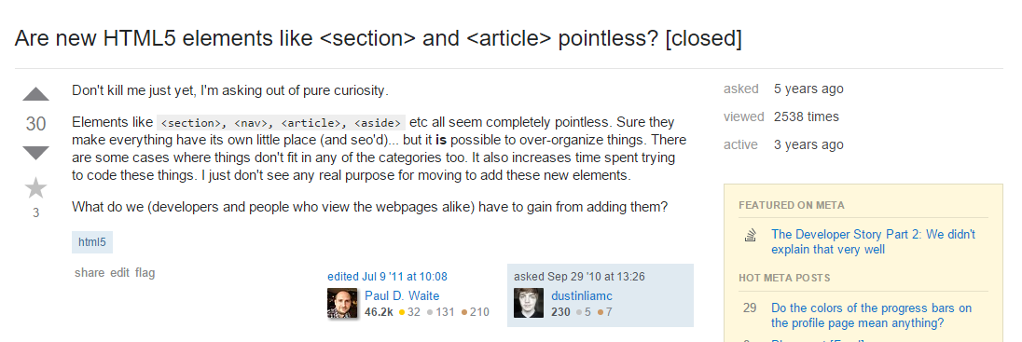
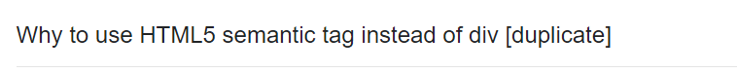
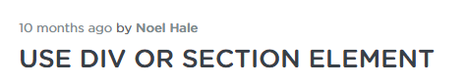
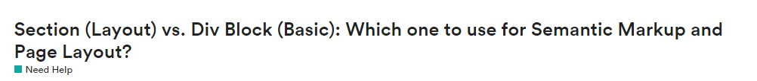
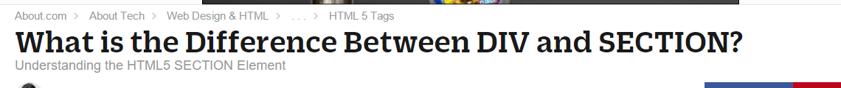
Divs, Sections, Navs, Etc….

Slide 22
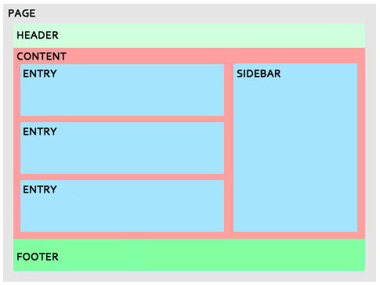
Divs, Sections, Navs, Etc….
All web layouts are inherently composed of containers, traditionally called “divs.”

Slide 23
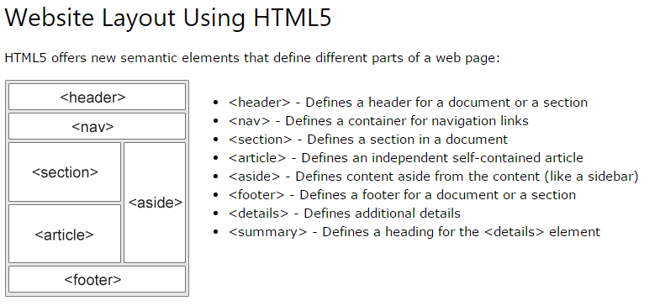
Divs, Sections, Navs, Etc….
HTML5 introduced the concept of “semantic layouts,” meaning “divs” could be given more meaningful names.
In theory, this helps with organization and search engine optimization.

Slide 24
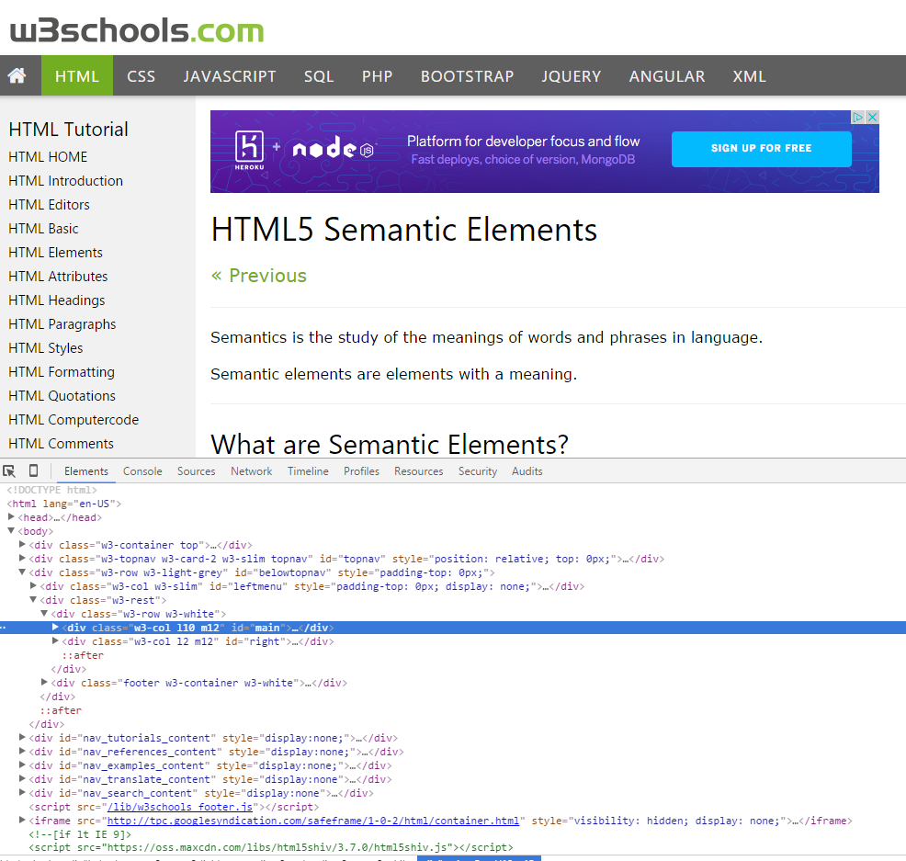
Divs, Sections, Navs, Etc….
That said… many (if not most) websites, seem to still be using basic divs.
There are reasons for this that we’ll showcase in later sections.
Additionally, it’s possible to include “semantics” by using id names and classes.

Slide 25
Divs, Sections, Navs, Etc….
div?
Section?
Bottom line: Follow your homework’s instructions. But when you get out in the “real world,” follow the convention of where you work!

Slide 26

Classes vs. IDs
Classes = Barcode (all iPod)
IDs = Serial Number (unique iPod)
When choosing between a CSS ID and a CSS Class follow the convention:
Classes (.classname) are to be used if the same style will be used on multiple HTML elements.
IDs (#idname) are to be used if a style is unique to that HTML element.

Slide 27
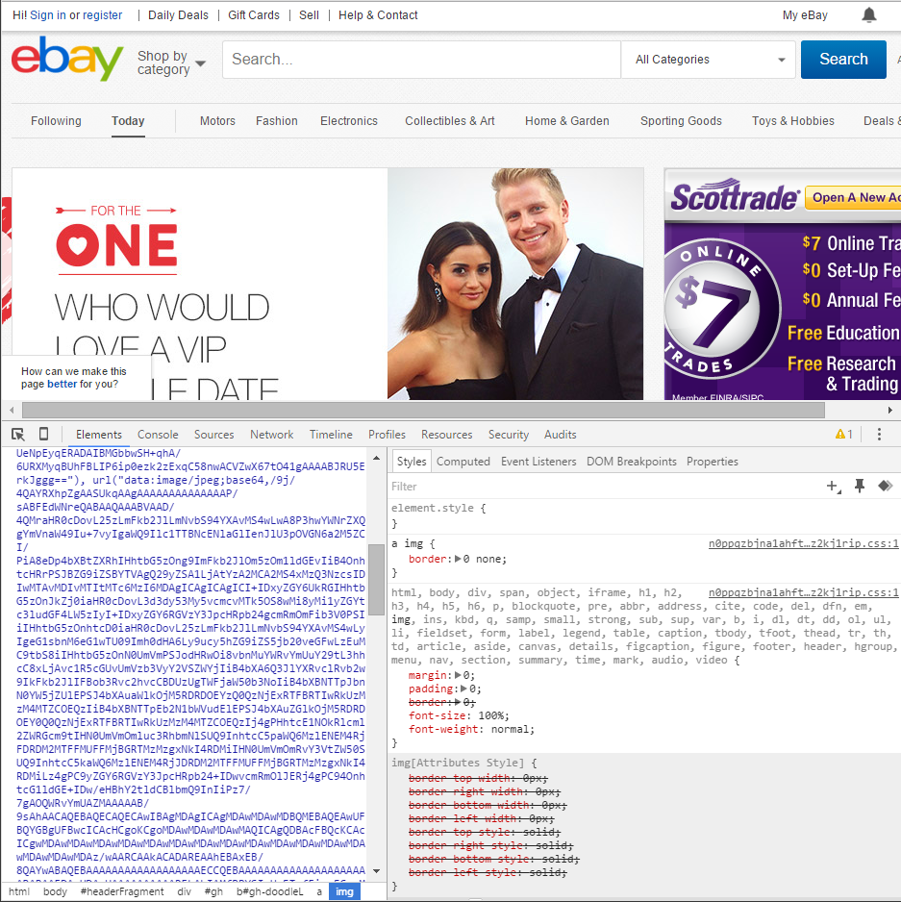
Chrome Developer Tools (Inspector)
This is one of the most frequent tools you will use in web development.
It allows you to truly debug your web designs.
Start using it!

Slide 28

Modifying Sites
You can edit any page’s HTML and CSS with Chrome Developer Tools.
Plus, you’ll see your results instantly.

Slide 29
INSTRUCTOR DEMO!
Instructor: Demo
(Chrome Developer Tools)
Notes:
29

Slide 30
> YOUR TURN!!
Suggested Time: 15 min
Assignment
For the next 15 minutes, take a website you commonly use (Amazon, Google, Huff Po, etc.) and heavily modify it using the Chrome Developer Tools.
Be sure to at least modify:
Content (Change words)
Colors
Spacing
Send a screenshot to the class’s slack profile when you’re done.

Slide 31
> YOUR TURN!!
Suggested Time: 10 min
Assignment
For the next 10 minutes, edit any site that you’ve been working on in-class or for homework with Chrome Developer Tools.
Be sure to at least modify:
Content (Change words)
Colors
Spacing

Slide 32
CSS Resets

Slide 33

Loading Multiple CSS Files ***(Very Important!!!)***
An incredibly powerful technique: deploying multiple CSS files simultaneously.
This lets developers to create complex designs made up of abounding design elements.
Just remember: the loading order matters!!!

Slide 34
INSTRUCTOR DEMO!
Instructor: Demo
(1-3_CSSFiles.html | 3-MultipleCSS)
Notes:
34

Slide 35
What Browser?
By a show of hands…
Which browser do you use?

Slide 36

Battle of the Browsers
Under the hood, web browsers often render web pages differently than their competition.
These disparities could mean HTML/CSS displaying differently in each web client.
Because of these potential divergences, web developers need to make their websites cross-browser compatible.

Slide 37

Reset.css (or Normalize.css)
Reset.css will “reset” all browser-specific CSS. This means your site will appear the same in all browsers.
However, you will have to re-style everything yourself.

Slide 38
INSTRUCTOR DEMO!
Instructor: Demo
(Example.html | 4-ResetCSS)
Notes:
38

Slide 39
Why CSS Resets Matter
It’s important for creating browser-compatible websites
It’s an example of using someone else’s CSS in your website!!!
It’s a common Front-End Developer Interview question.

Slide 40
> YOUR TURN!!
Suggested Time: 10 min
Assignment
Follow the instructions given via Slack to incorporate a reset.css file into a basic HTML file.
Note the impact the reset file makes after its inclusion.

Slide 41
To the Web with GitHub!

Slide 42
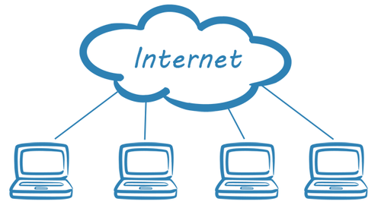
The Internet
A deep and complex diagram above on how the internet works.

Slide 43
The World Will See Our Greatness!
GitHub provides hosting for static websites – which means we can deploy our websites and applications onto their servers for the world to see.

Slide 44
Together Now…
Let’s all login to GitHub

Slide 45
INSTRUCTOR DEMO!
Instructor: Demo
(GitHub Pages Deployment - Personal)
Notes:
45

Slide 46
Deploying Static Personal Site – GitHub Pages
Basic Steps:
Create a new repo that is named `_username_.github.io`
Navigate into a folder and clone the repo into it
Build your files
Add, commit, and push your changes into the repository

Slide 47
> YOUR TURN!!
Suggested Time: 15 min
Assignment
Time to take your newfangled website and deploy it to the cloud (in this case, GitHub Pages).
Additional instructions to be sent via Slack.

Slide 48
INSTRUCTOR DEMO!
Instructor: Demo
(GitHub Pages Deployment - Project)
Notes:
48

Slide 49
Deploying a Static Project Site – GitHub Pages
Basic Steps:
1. Create a new repository on your GitHub account. You can name this repository whatever you would like.
2. Once inside of the repository, create a new file and name it `index.html`
3. Add some very basic HTML into this file, save it, and then navigate into your repository's Settings tab.
4. Scroll down to the GitHub Pages section and then, in the section labeled "Source", select that you would like to use the master branch as your source.
5. Navigate to `<username>.github.io/<repositoryname>` and you will find that your new web page has gone live!

Slide 50
> YOUR TURN!!
Suggested Time: 15 min
Assignment
Build a newfangled website, and deploy it to GitHub Pages as a project instead of a personal site.
Additional instructions to be sent via Slack.

Slide 51
Practice Through Frustration
Keep Practicing!
It gets better.

Slide 52
Questions?

Slide 53
Homework 1 - Help?

Slide 54
EXTRA MATERIAL

Slide 55
And Back to Git…

Slide 56

The Group Project
OMG. I HAZ THE GREATEST HTML IDEA!!!!!
SpongeSite.com
Notes:
56

Slide 57

The Group Project
Programming Away…
Spongebob’s idea is dumb. We should call it…
PrincezzzSite.com
Notes:
57

Slide 58
The Group Project
The Group Project – Tragedy #1
Programming Away…
Now they have two completely different versions.
Programming Away…
Notes:
58

Slide 59
The Group Project – Push vs Pull
Main Branch (Spongebob’s)
Spongebob continues programming
1
2
3
4
5
This is NON-IDEAL
Prince pushes his code changes into the main branch.
If Prince is allowed to push his code, it could seriously ruin Spongebob’s vision and working code.
Prince’s Branch
Notes:
59

Slide 60
The Group Project – Push vs Pull
Main Branch (Spongebob’s)
Spongebob continues programming
1
2
3
4
5
Prince’s Branch
Notes:
60

Slide 61
The Group Project – Push vs Pull
Main Branch (Spongebob’s)
Spongebob continues programming
1
2
3
4
5
Ideal Approach – Using Pull Requests
Because Spongebob controls the “master branch” he must elect to pull Prince’s Code. All Prince can do is submit a “pull request”
This is the ideal way to maintain code in version control.
?
Prince’s Branch
Notes:
61

Slide 62
General Steps for Git Pull Requests
Create a new branch of on your local computer git branch <BRANCH NAME>
Checkout that branch (locally) on your machine git checkout <BRANCH NAME>
Add / Commit your changes (will automatically save to this branch) git add –A git commit –m “Comment”
Push your branch to GitHub
git push origin <BRANCH NAME>
Submit a Pull Request on GitHub
Other user must accept these changes on GitHub

Slide 63
INSTRUCTOR DEMO!
Git Pull Request
Notes:
63

Slide 64
> YOUR TURN!!
Assignment
Time to take your newfound collaborative git skills to the real-world. Find a partner and follow the steps sent via slack to
Share each other’s code
Make modifications
Submit a Pull Request
Accept the Pull Changes

Slide 65
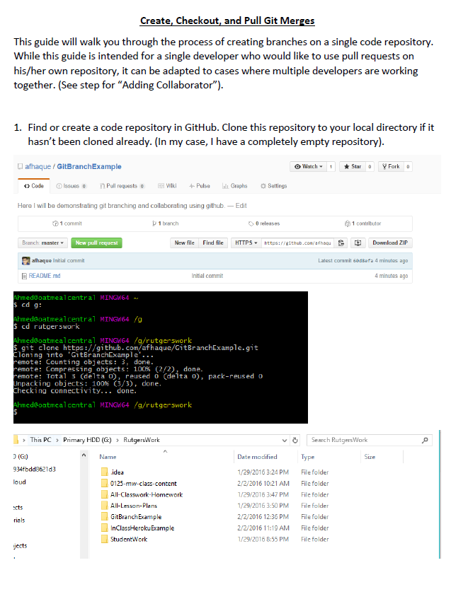
Follow our Guide!
Step-by-step guide
on creating Git Pull Requests

Slide 66
Don’t Worry!
We’ll be coming back to this.
You won’t need this fully until Week 8.
Notes:
66

Slide 67
Practice At Home
But practice when you can!
You don’t need a partner to submit pull requests!
Notes:
67

